Slide 1
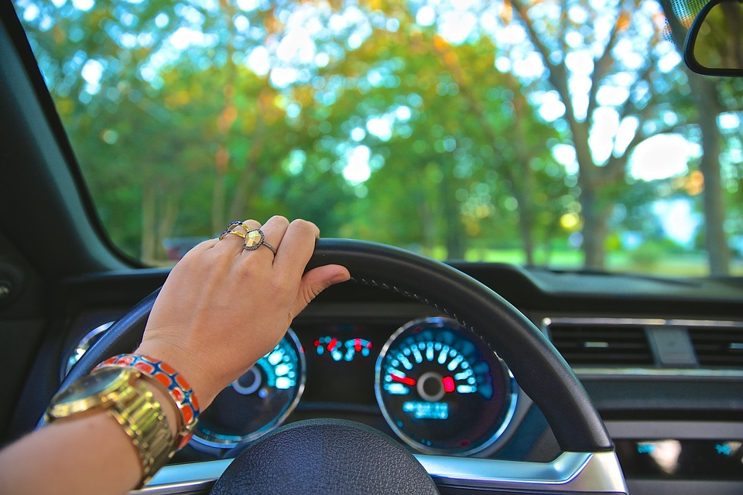
You’re sitting in the driveway of your house in Indiana. You’re ready to take a vacation and want to decide where to go on a whim, just for the excitement of it. Your house is on a north-south highway. Which way do you turn, left to go south or right to go north?
Want access to this file? Please don’t click the “Share” button. Instead, click “File > Make a copy …” to copy it into your Google Drive. Thanks!
Turn left (south)
Turn right (north)

Slide 2

You turn right and head north. You’re cruising for about an hour, jamming out to your favorite radio station. Suddenly, traffic grinds to a halt. It doesn’t look like it’s going to improve any time soon. Do you wait it out or take the gravel road that sits right next to you?
Wait it out
Take the gravel road

Slide 3

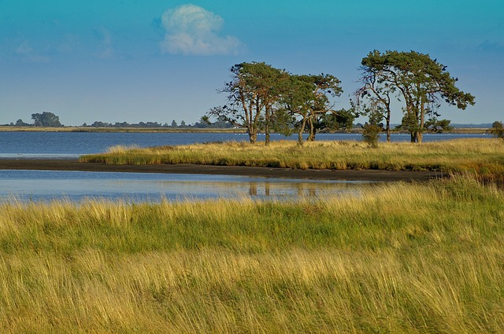
You turn left and head south. Hours pass quickly as you’re driving on the highway with fairly little traffic. As you head south, you see a small billboard for a scenic lake. For some reason, it catches your eye and makes you think. What do you do?
Scenic
Lake
Exit and go to the lake
Keep driving south

Slide 4
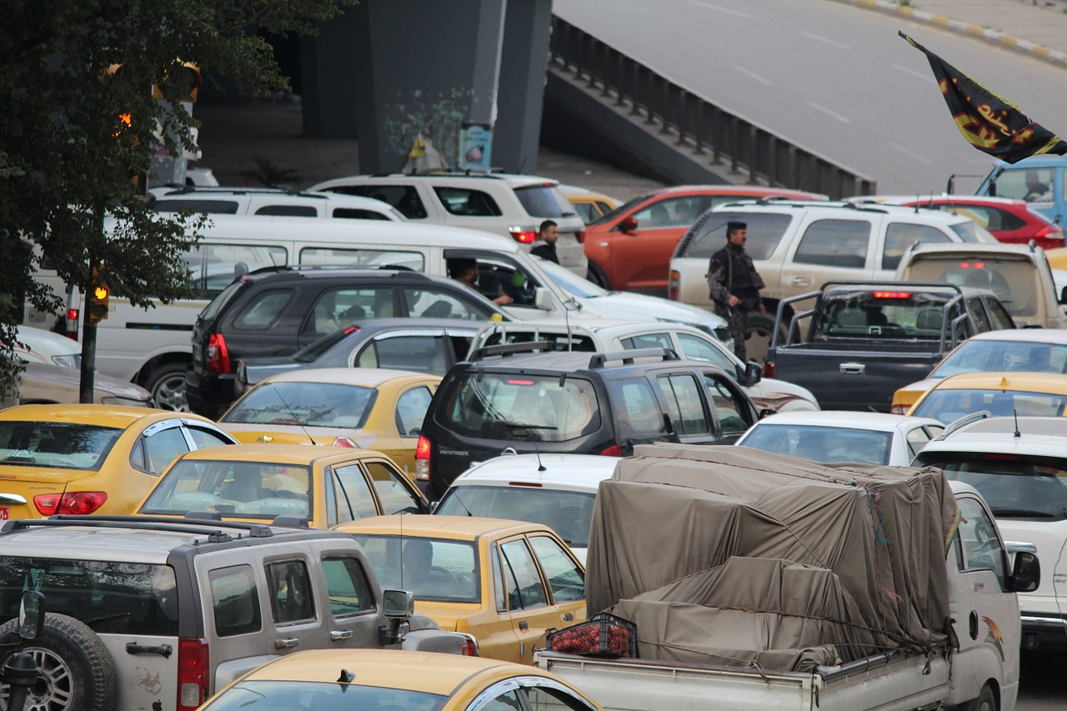
You decide to wait the traffic out. It’s totally gridlocked, and in your boredom, you look next to you in traffic. Somehow, the star of your favorite TV show is sitting in the car next to you, as bored as you are. You roll down your windows and start a conversation. After the traffic breaks, you both decide to go seek refreshment at a nearby establishment and strike up a conversation. It’s a memorable trip!
Return to the first slide and start over

Slide 5
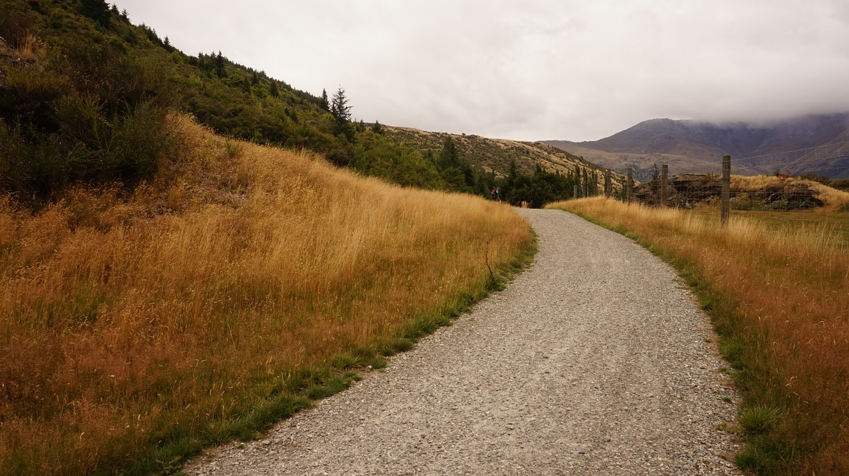
You turn down the gravel road, still seeking adventure. After winding through some curves and hills, you come upon a gorgeous waterfall with a walking trail. You never knew that this waterfall existed so close to your home! You walk, take pictures and just enjoy the beauty of nature. It’s a perfect start to your adventurous journey.
Return to the first slide and start over

Slide 6
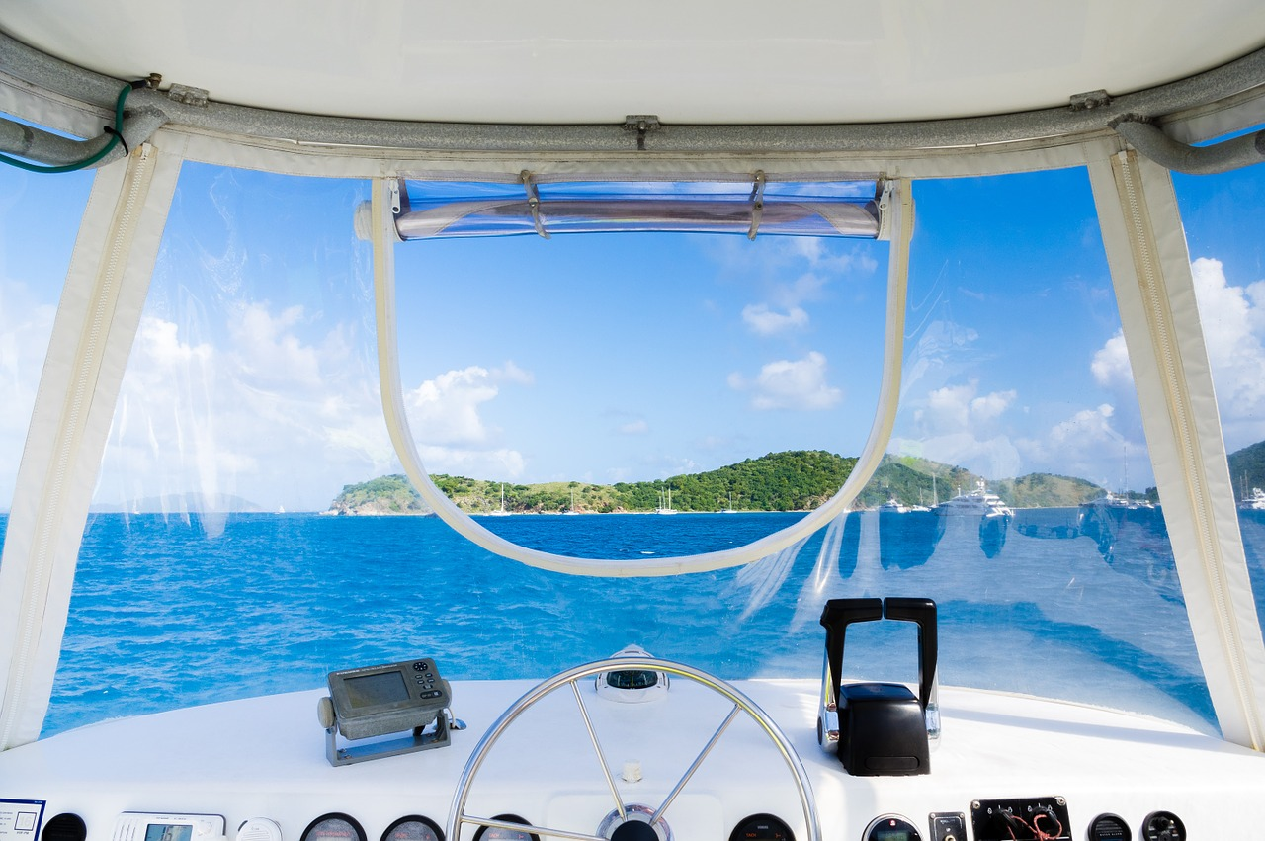
You take the exit off the highway and start seeking out the scenic lake. As you pull in, you notice a man standing next to an enormous yacht on the lake. You walk in his direction, and he tells you that his guests for the day have cancelled on him and he’d like you to accompany him on a fun day on the lake. It sounds too good to be true, and you have a decision to make ...
Return to the first slide and start over

Slide 7
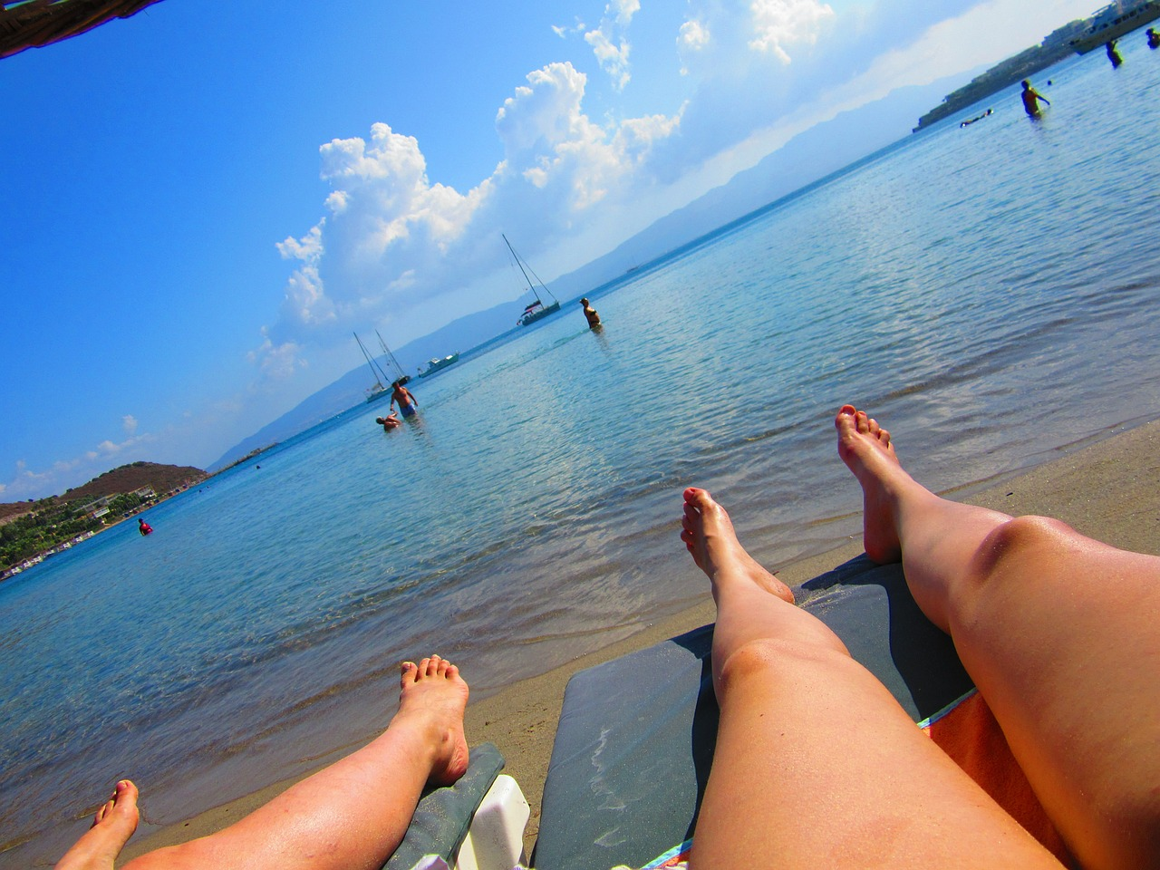
Your intuition tells you to stay the course and continue traveling south. After hours of driving, you start to get close to the Gulf of Mexico. You fill the next week sinking your toes in the sand, walking the shore of the gulf, enjoying delicious seafood and forgetting life’s worries. It is truly a relaxing and rejuvenating trip that you didn’t expect at the beginning.
Return to the first slide and start over

